Slide 1
Release-as-code Design sprint
November 2016

Slide 2
Goal
Make XL Release developer-friendly while keeping it friendly for non-developers.

Slide 3
What does that mean?
Allow templates, releases and other configuration objects to be defined as code.
Allow for dynamic definition of those objects.
Allow that code to be stored in SCM.
Provide a developer-friendly language.
Provide non-developer insight into what’s happening.

Slide 4
Choices/decisions
Language:
No JSON – too cumbersome.
No YAML – not dynamic enough.
Still to decide:
Python script or Groovy DSL.
How to invoke:
CLI.
Script task.
SCM trigger.

Slide 5
Requirements
Easy to learn
Compact
Declarative
Idempotent

Slide 6
Scenarios
Automatically setup multiple templates for maintenance branches, from the command line.
Automatically setup new teams, from a script task.
Run a dynamically generated release, from a trigger.

Slide 7
CLI in XL Release
What are we seeing?
CLI
Python DSL

Slide 8
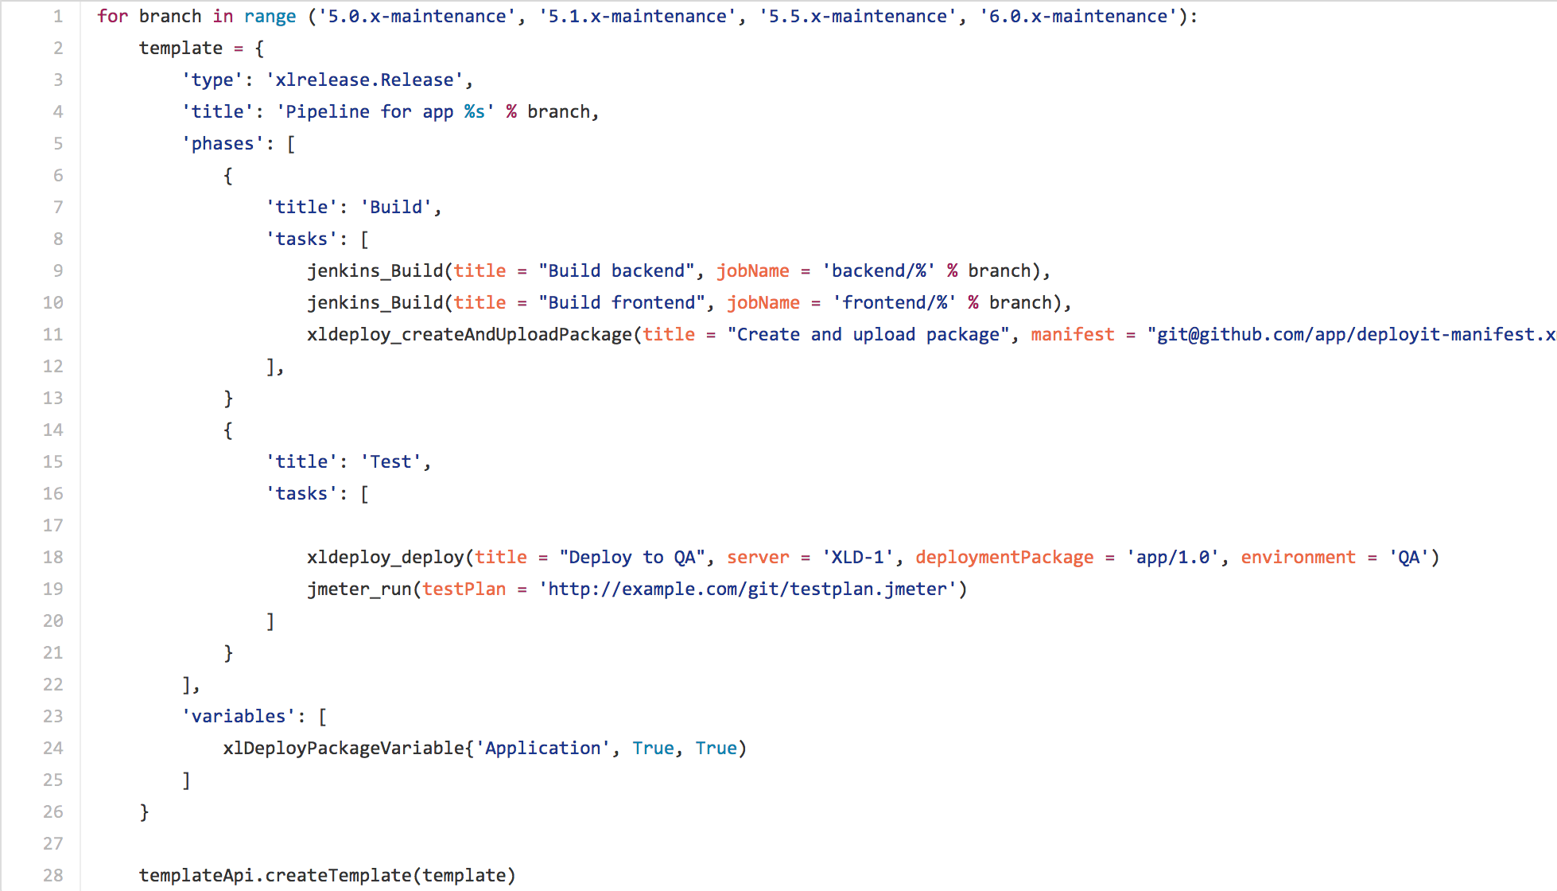
Python DSL

Slide 9
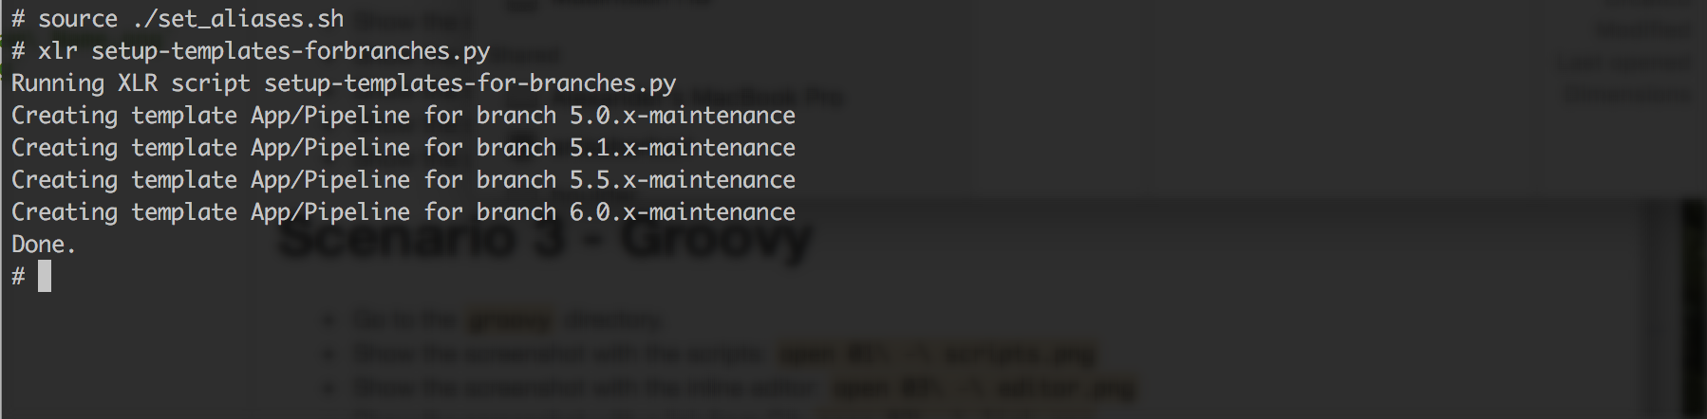
Executing from CLI

Slide 10
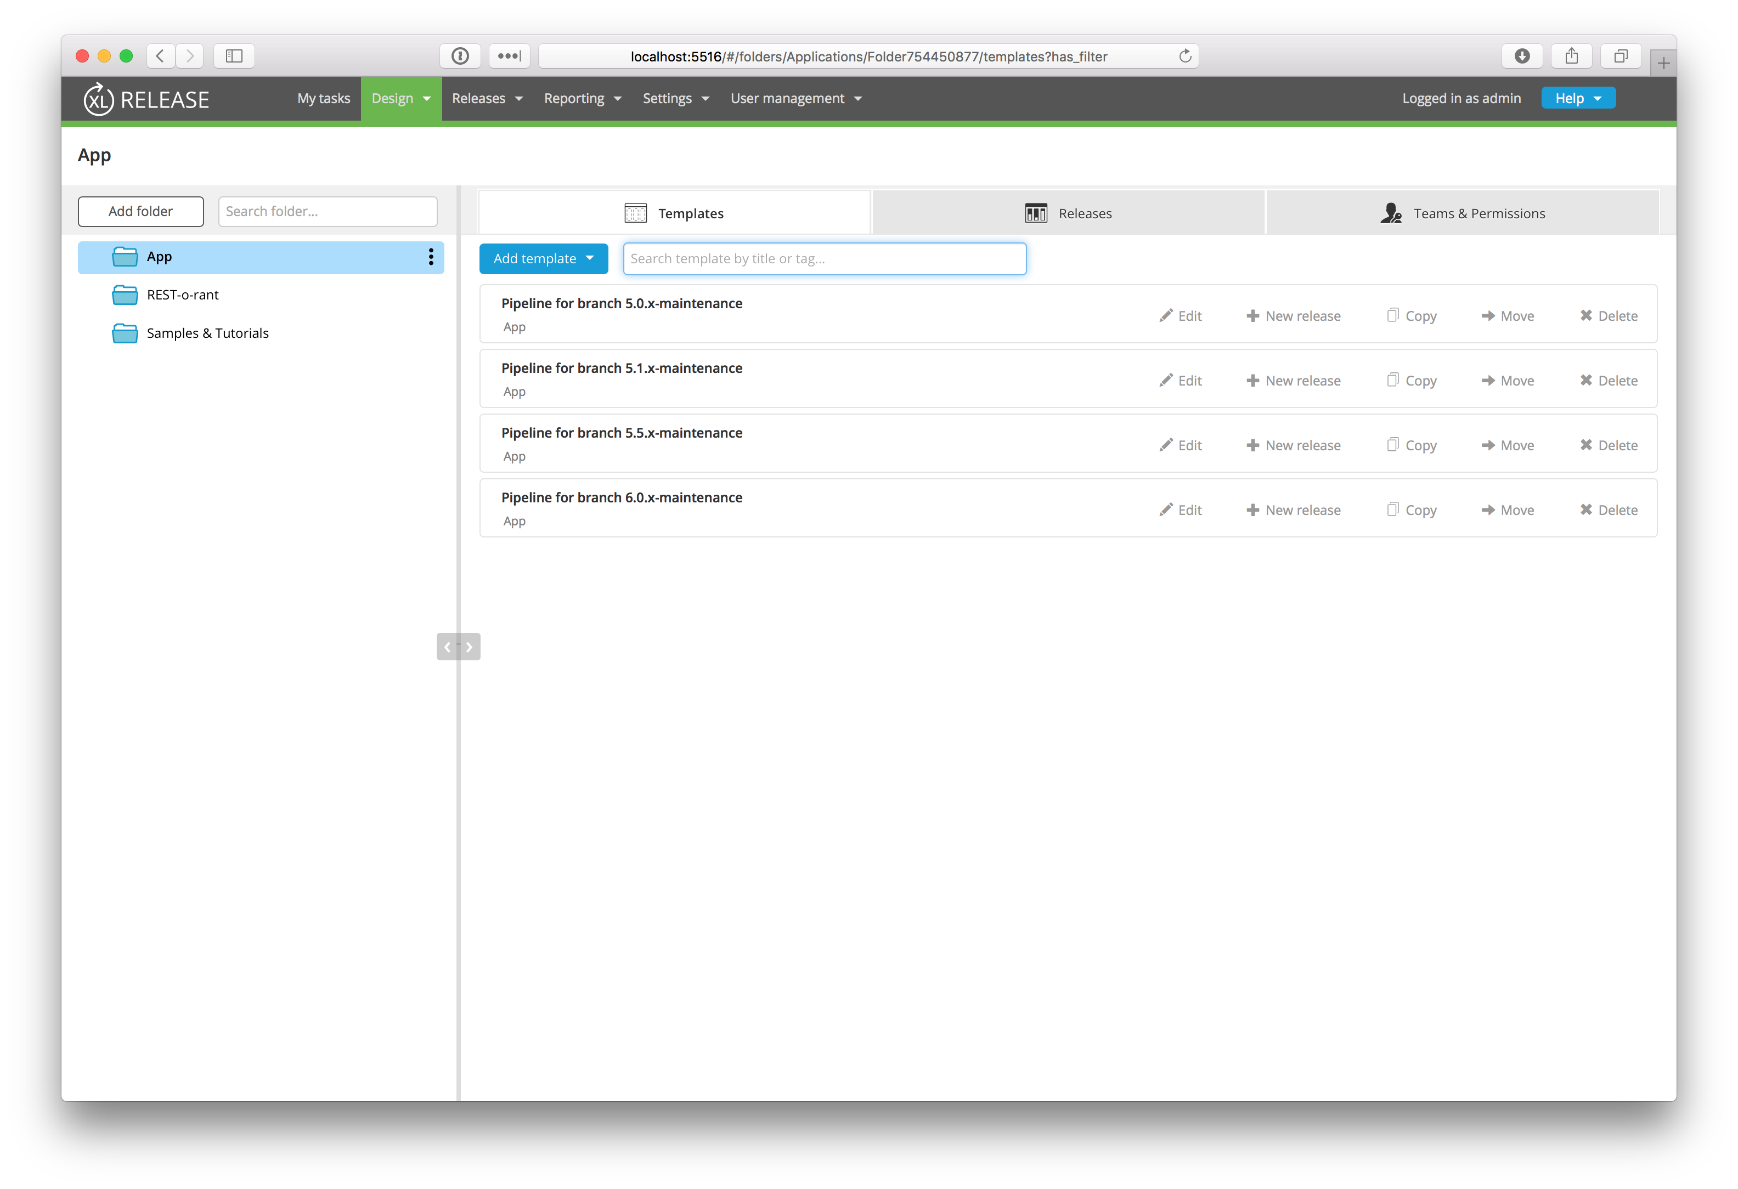
Results

Slide 11
Seeding Template From A Release
What are we seeing?
Script from task in a Release
Script creates a new template
Current Python

Slide 12
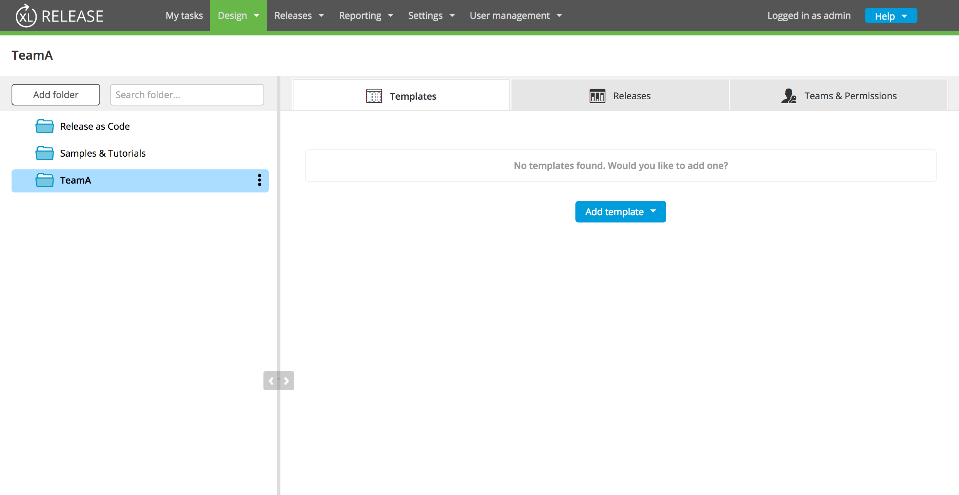
Team Folder

Slide 13
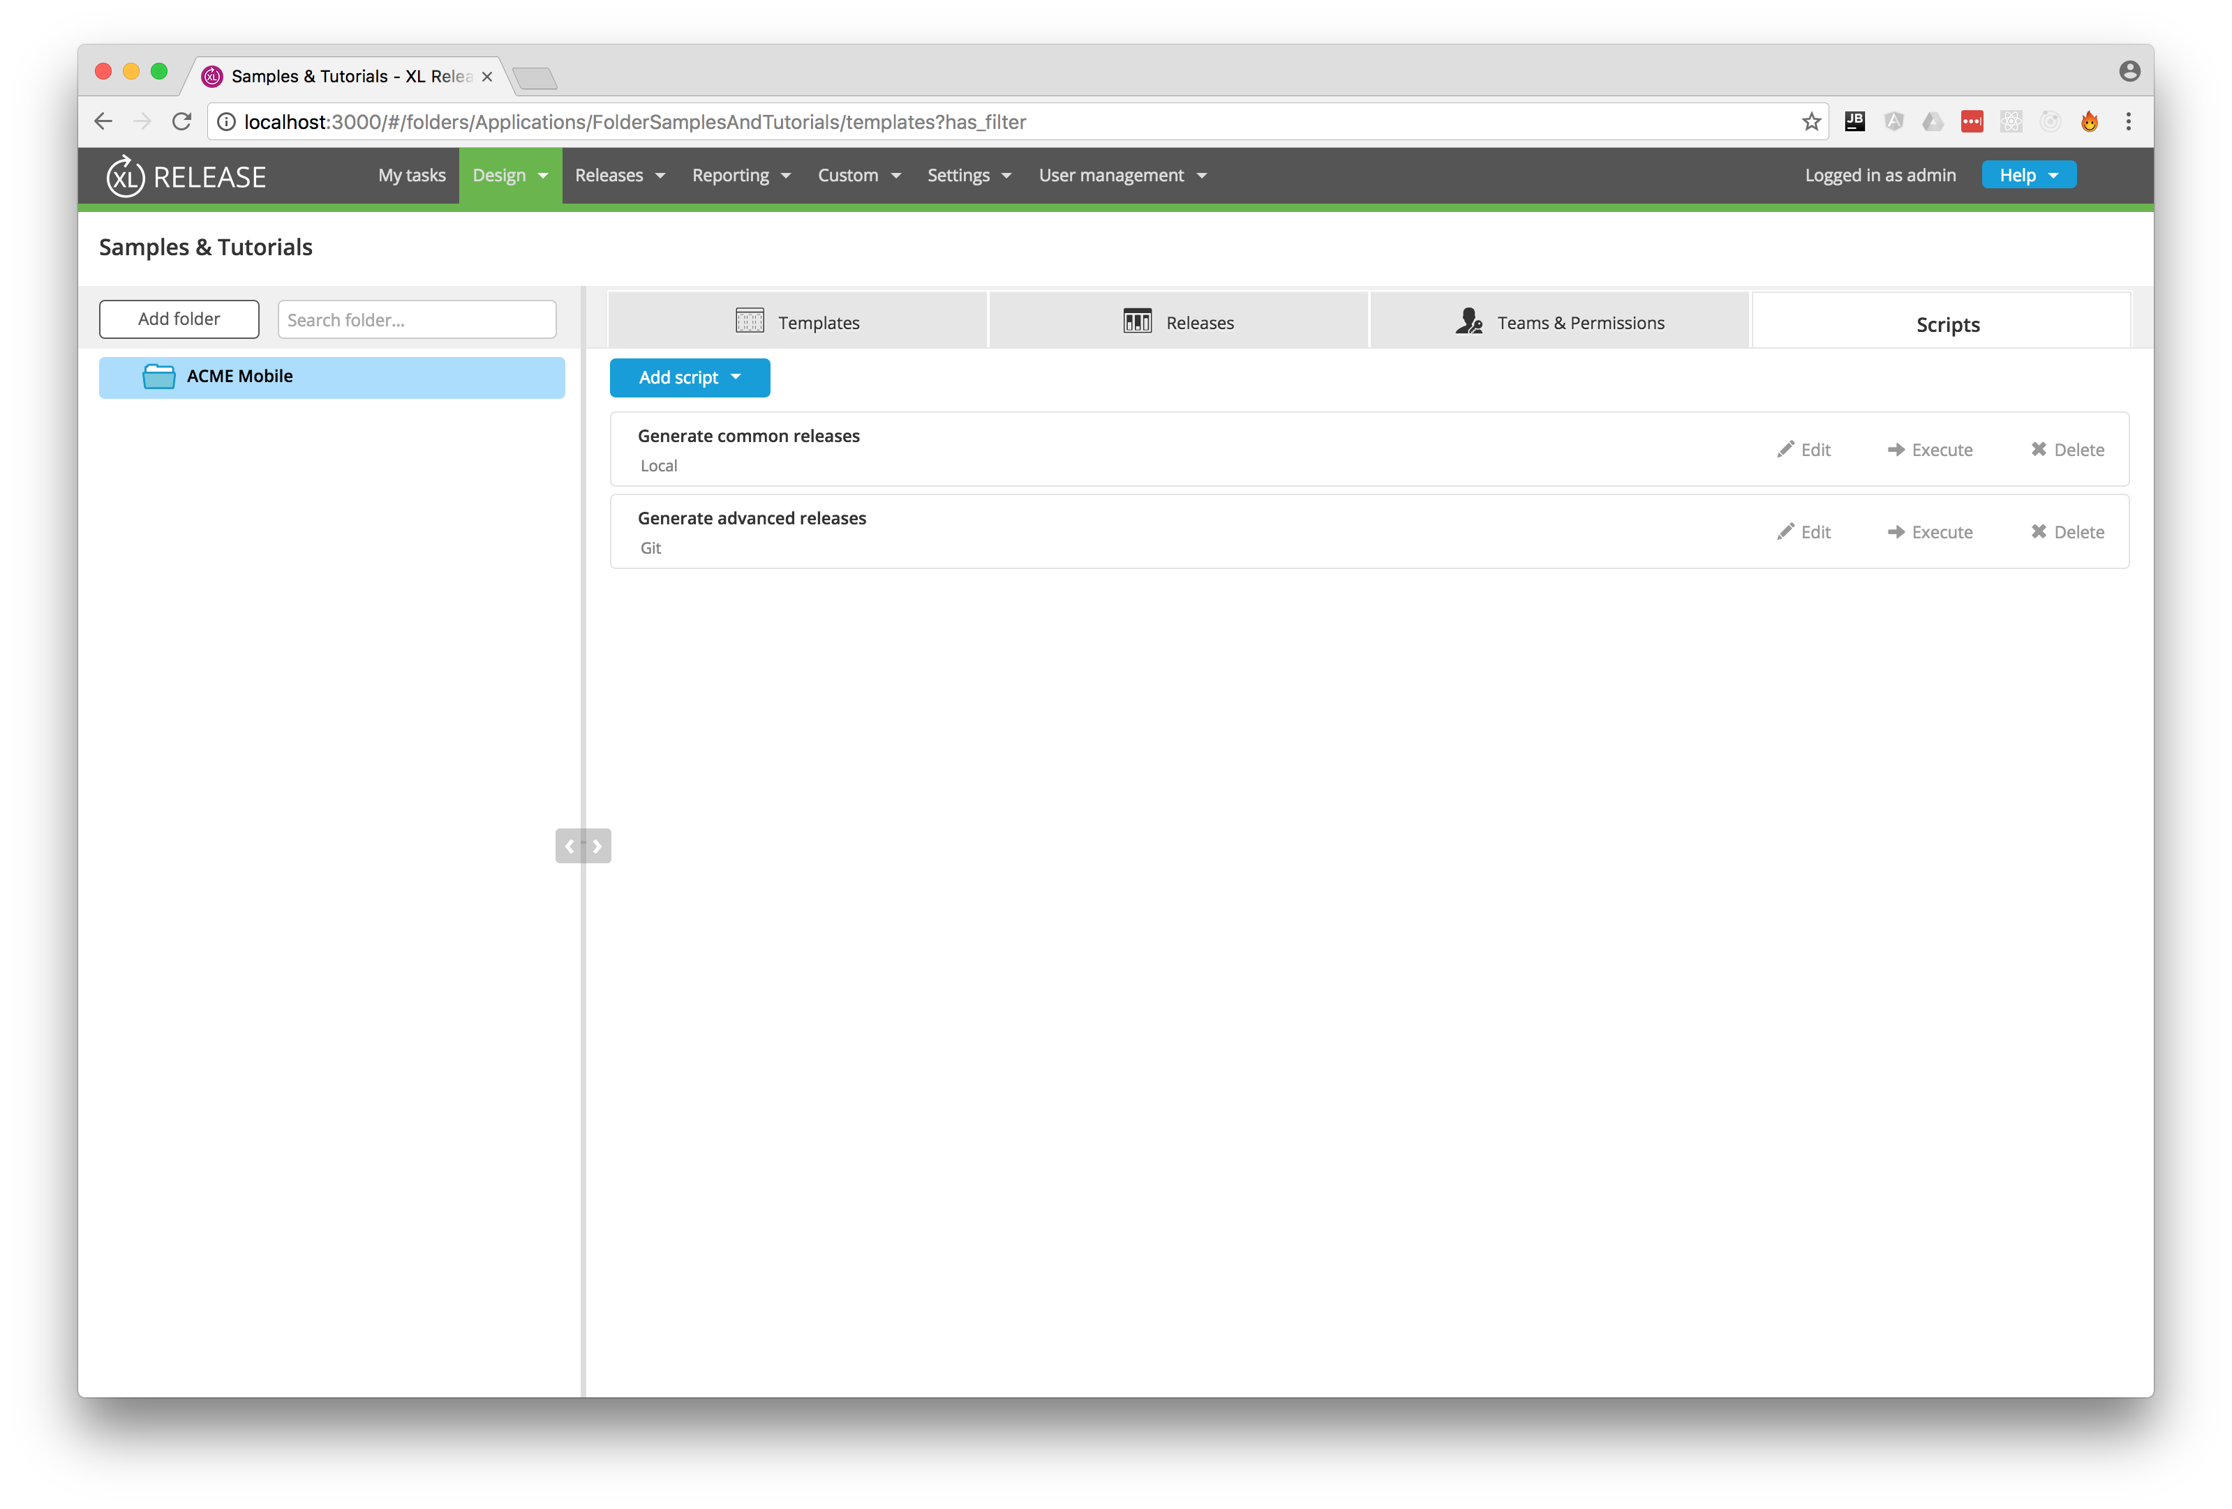
Adding Script Folder

Slide 14
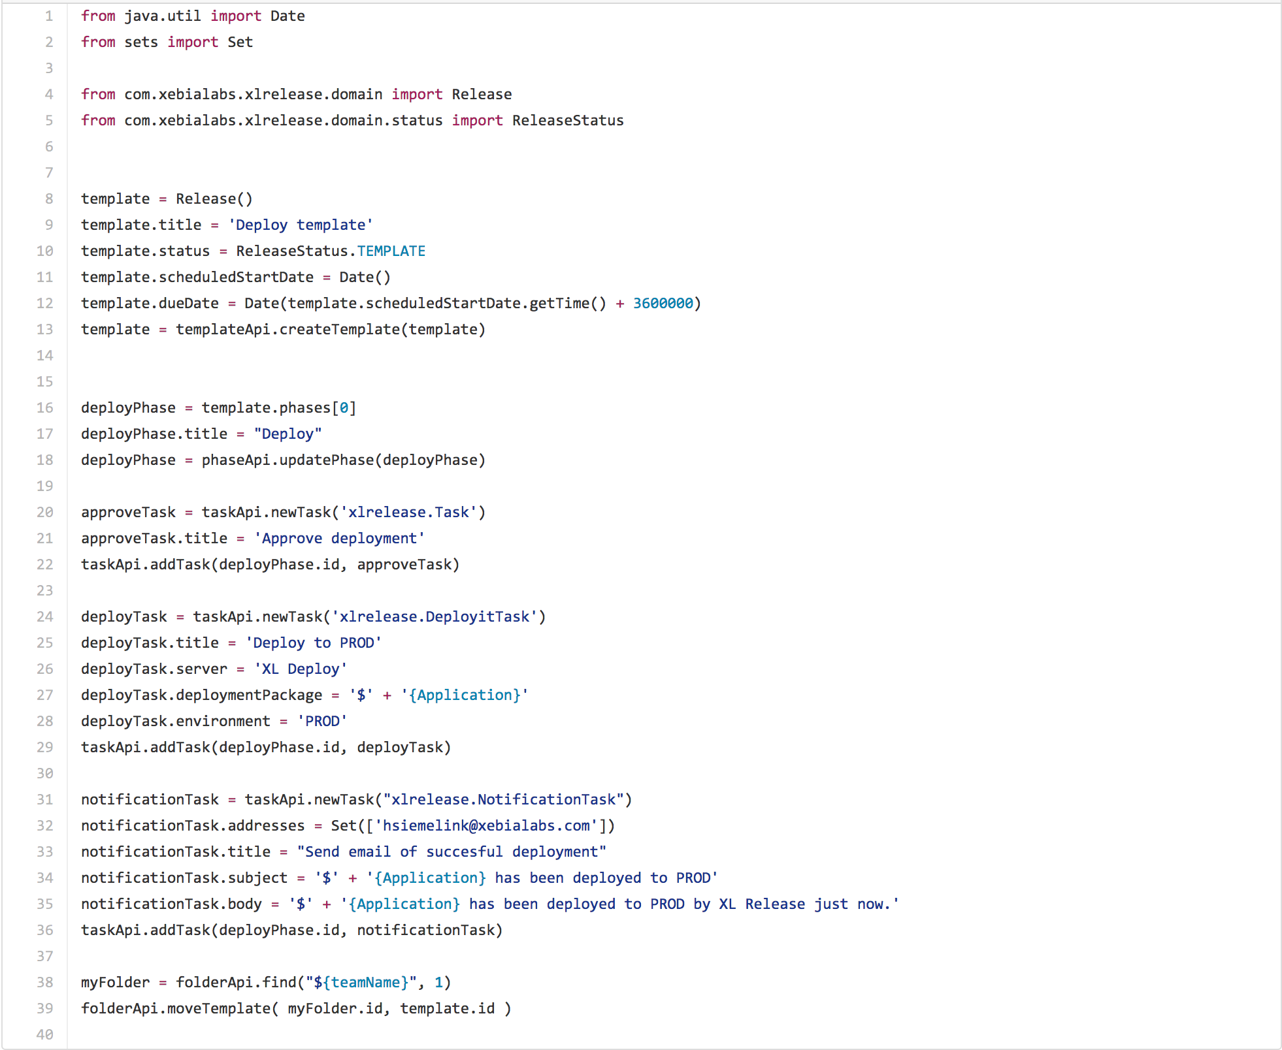
Script

Slide 15
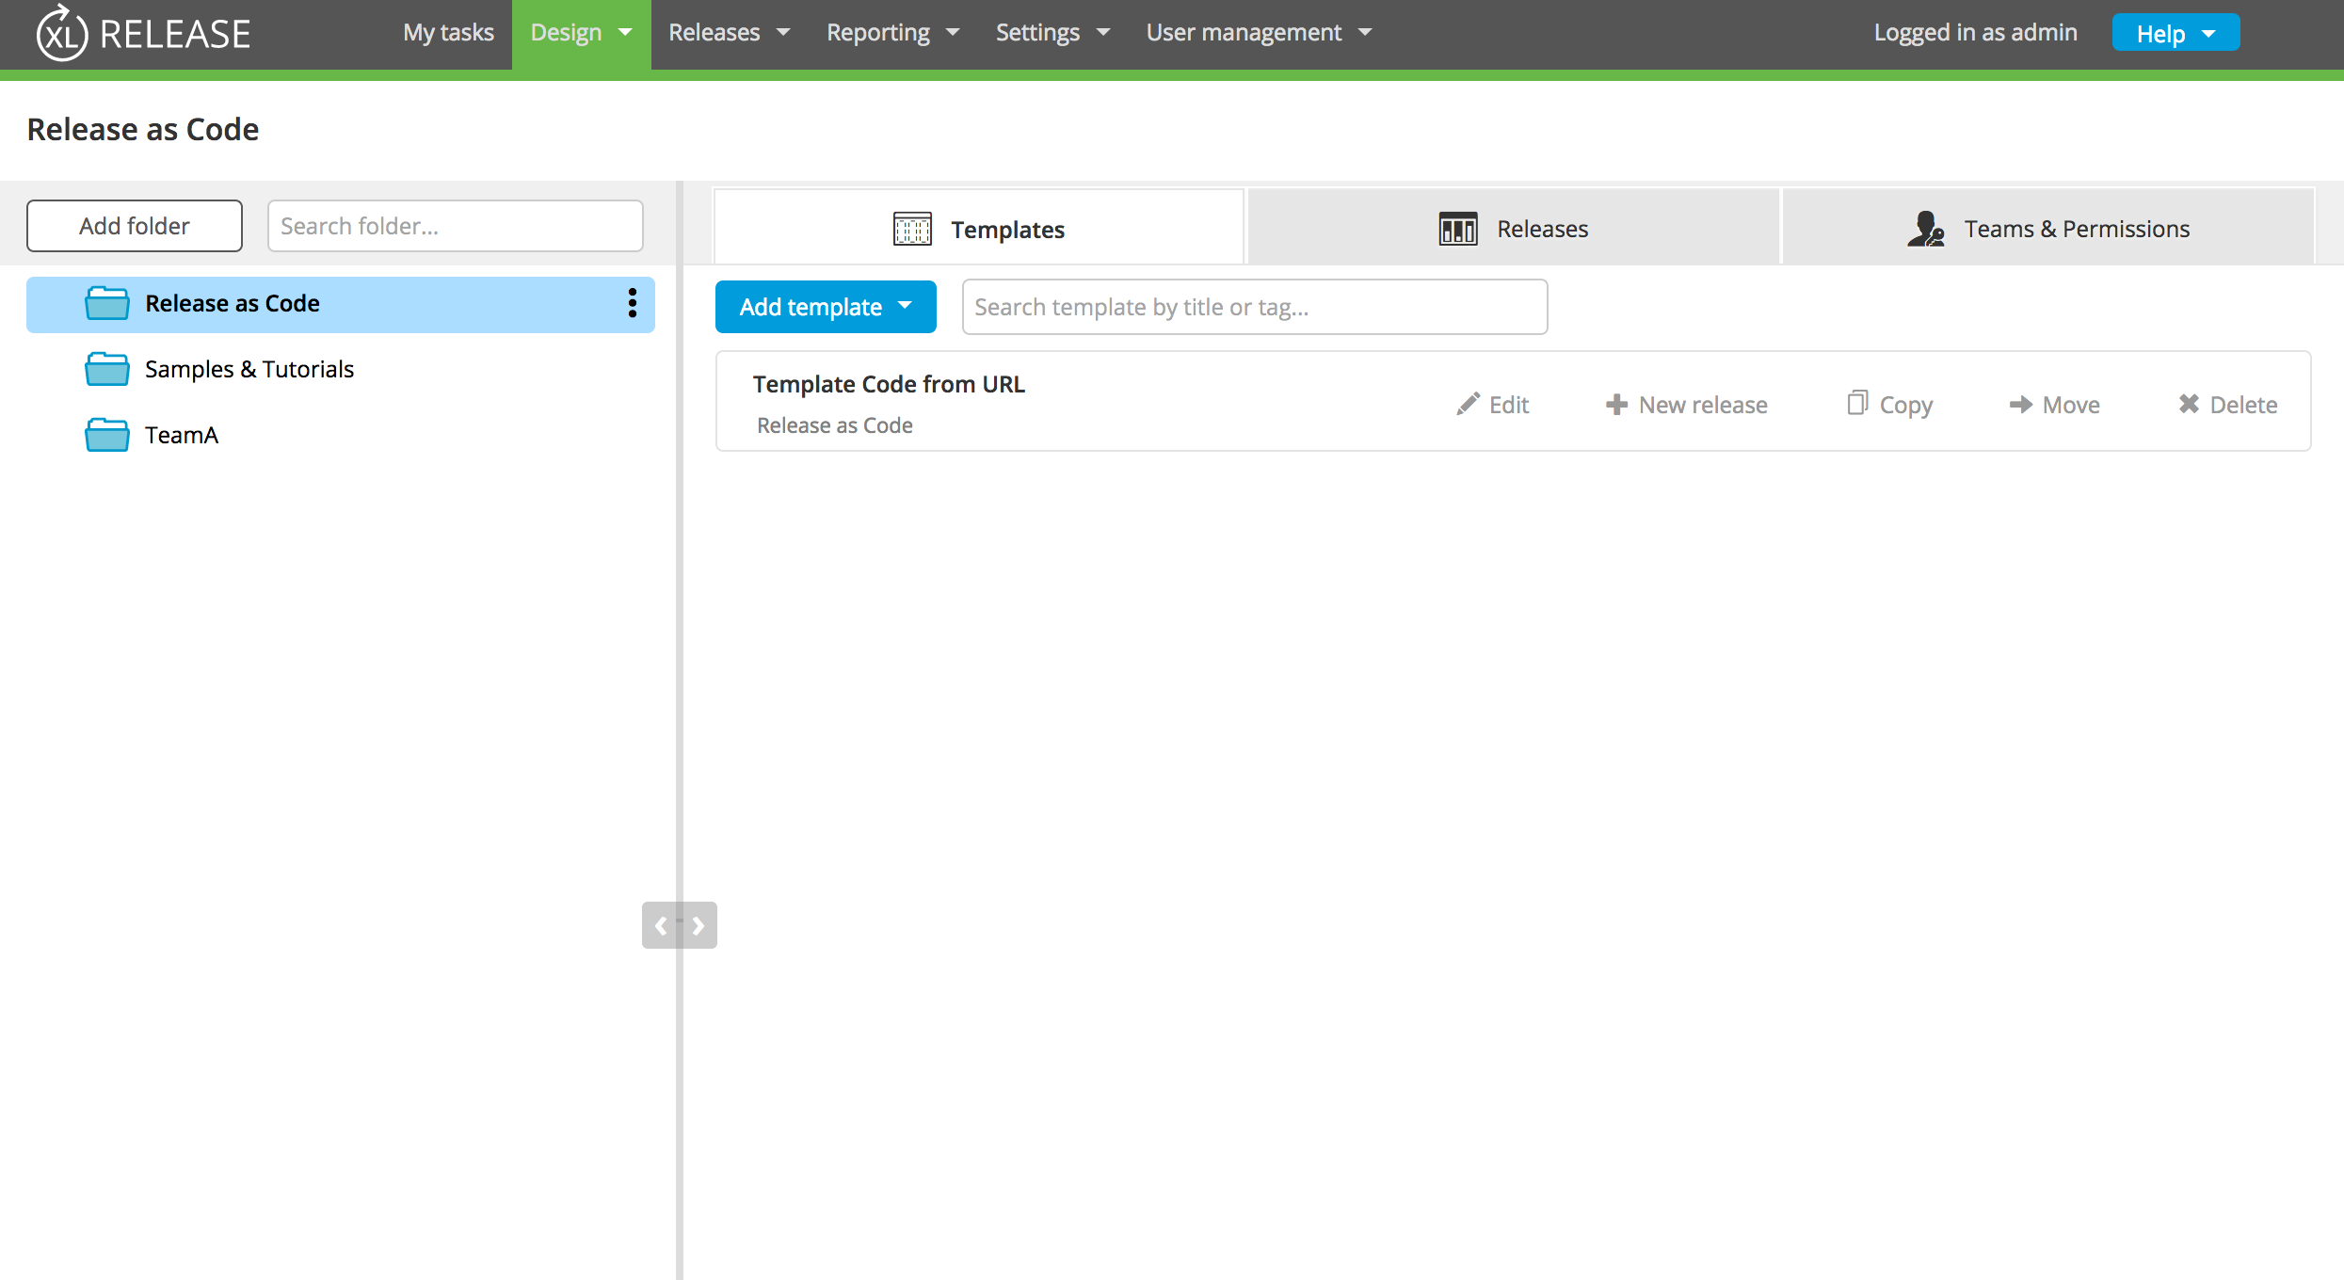
Release as Code Folder

Slide 16
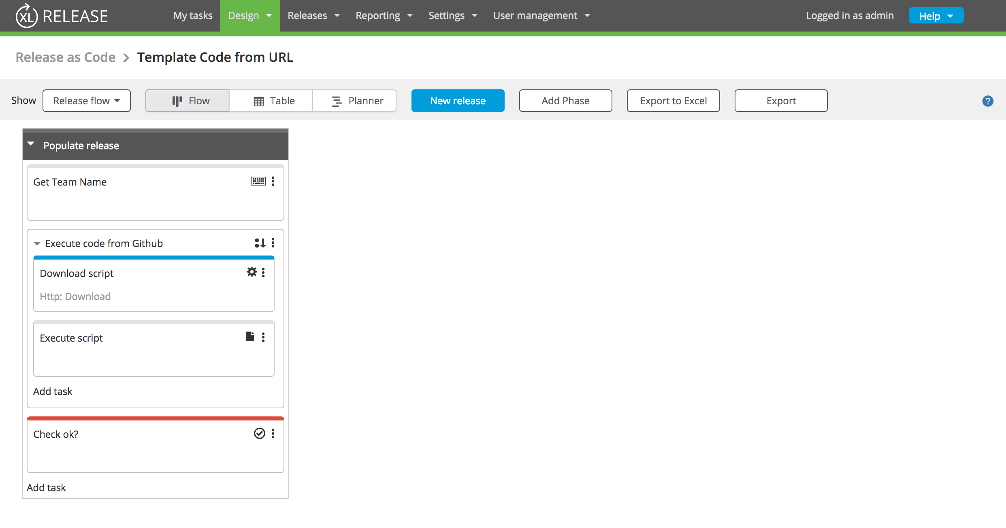
Release Template

Slide 17
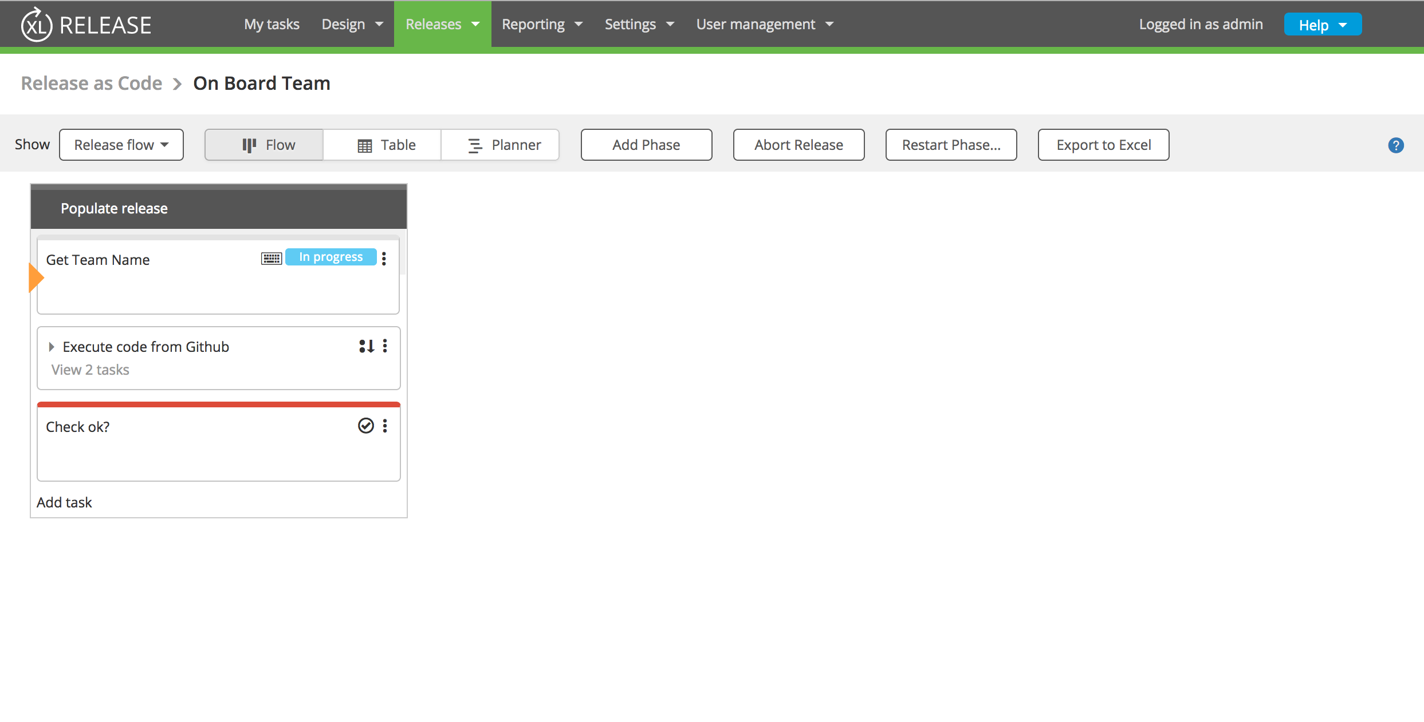
Release Start

Slide 18
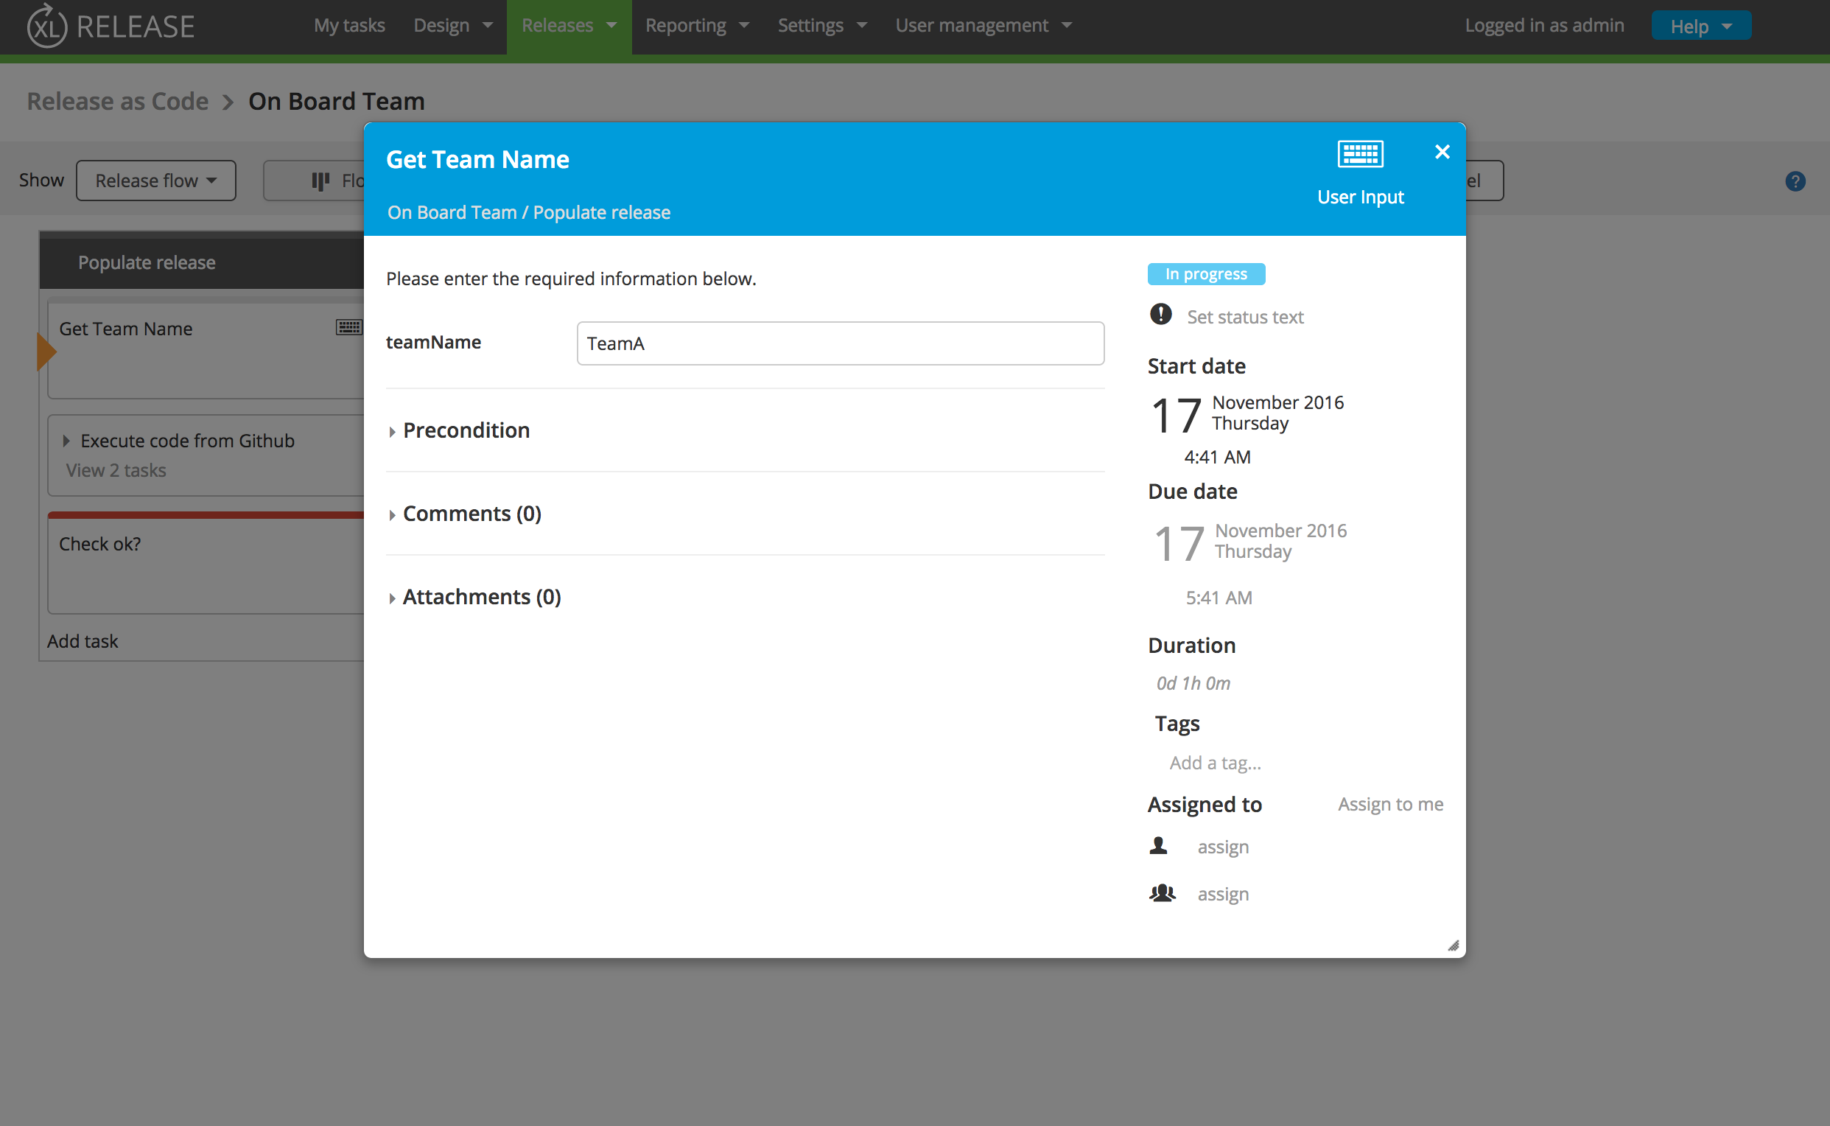
Set Release Team Name

Slide 19
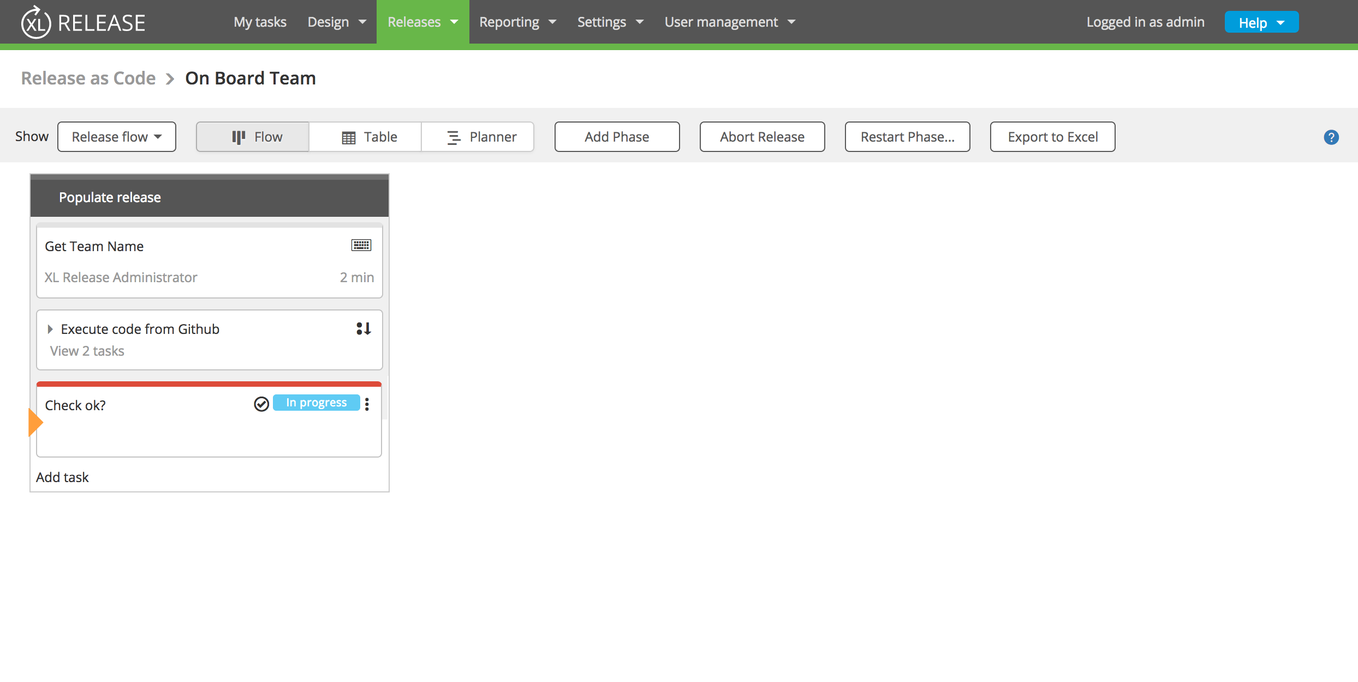
Release Script Executed

Slide 20
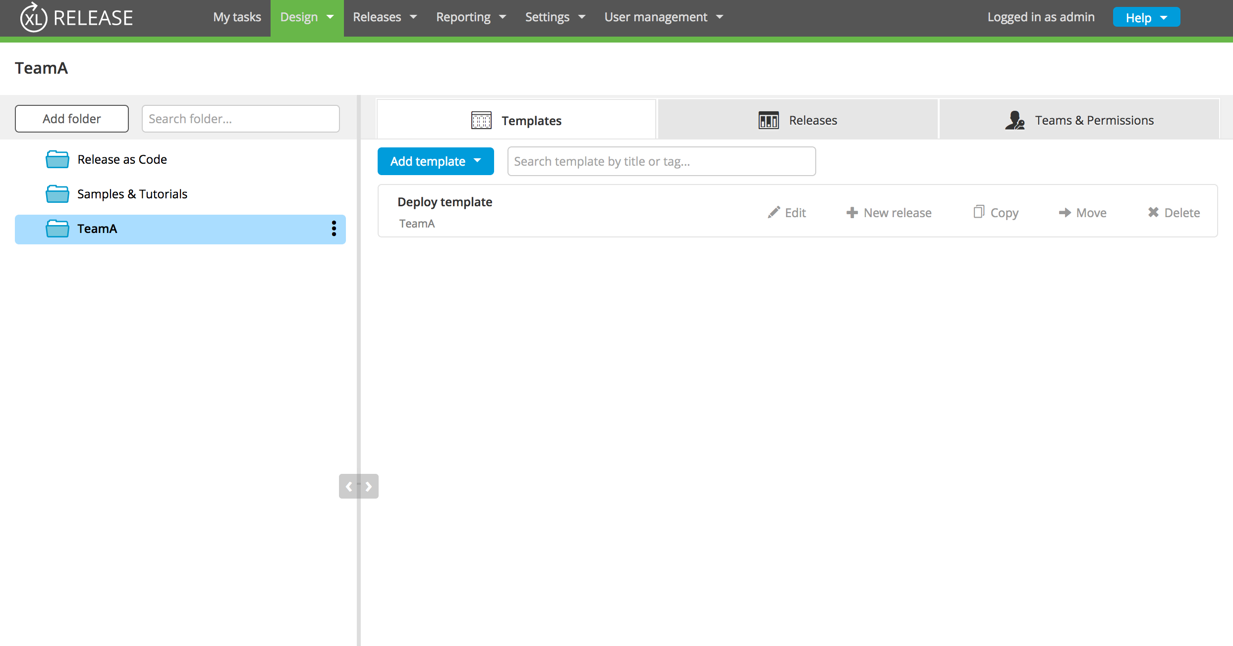
Release Team Folder Updated

Slide 21
Groovy DSL
What are we seeing?
Starting a release from a script
Groovy DSL

Slide 22
Scripts Tab In Folder

Slide 23
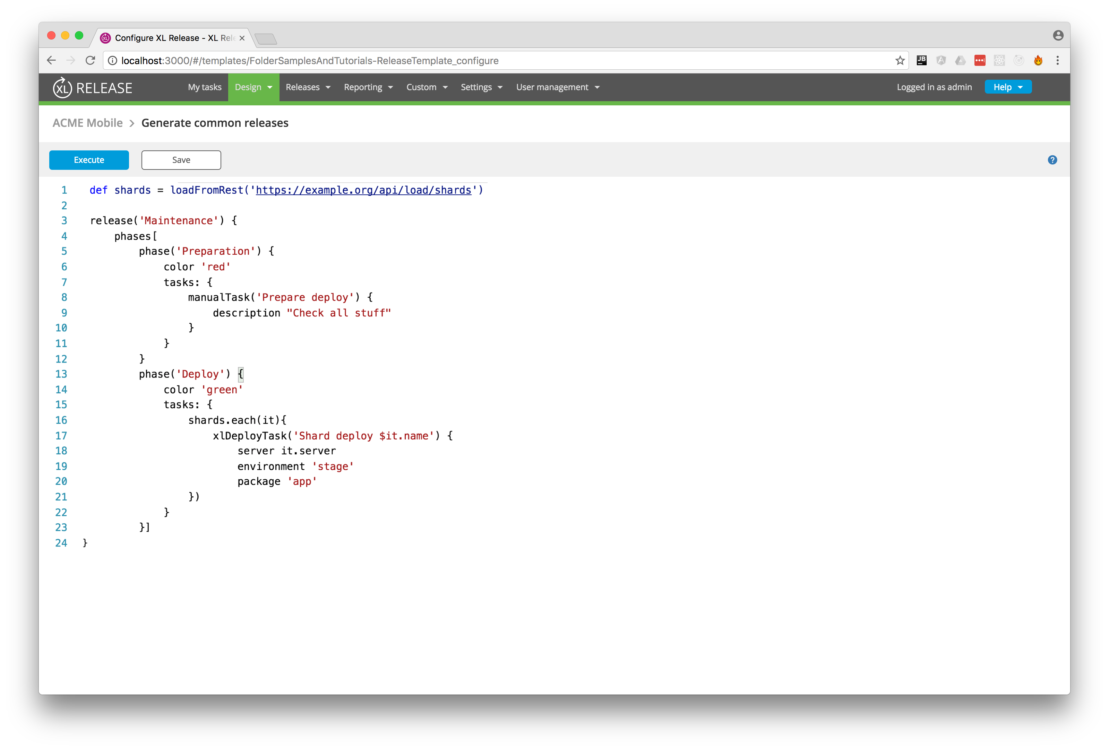
Editor

Slide 24
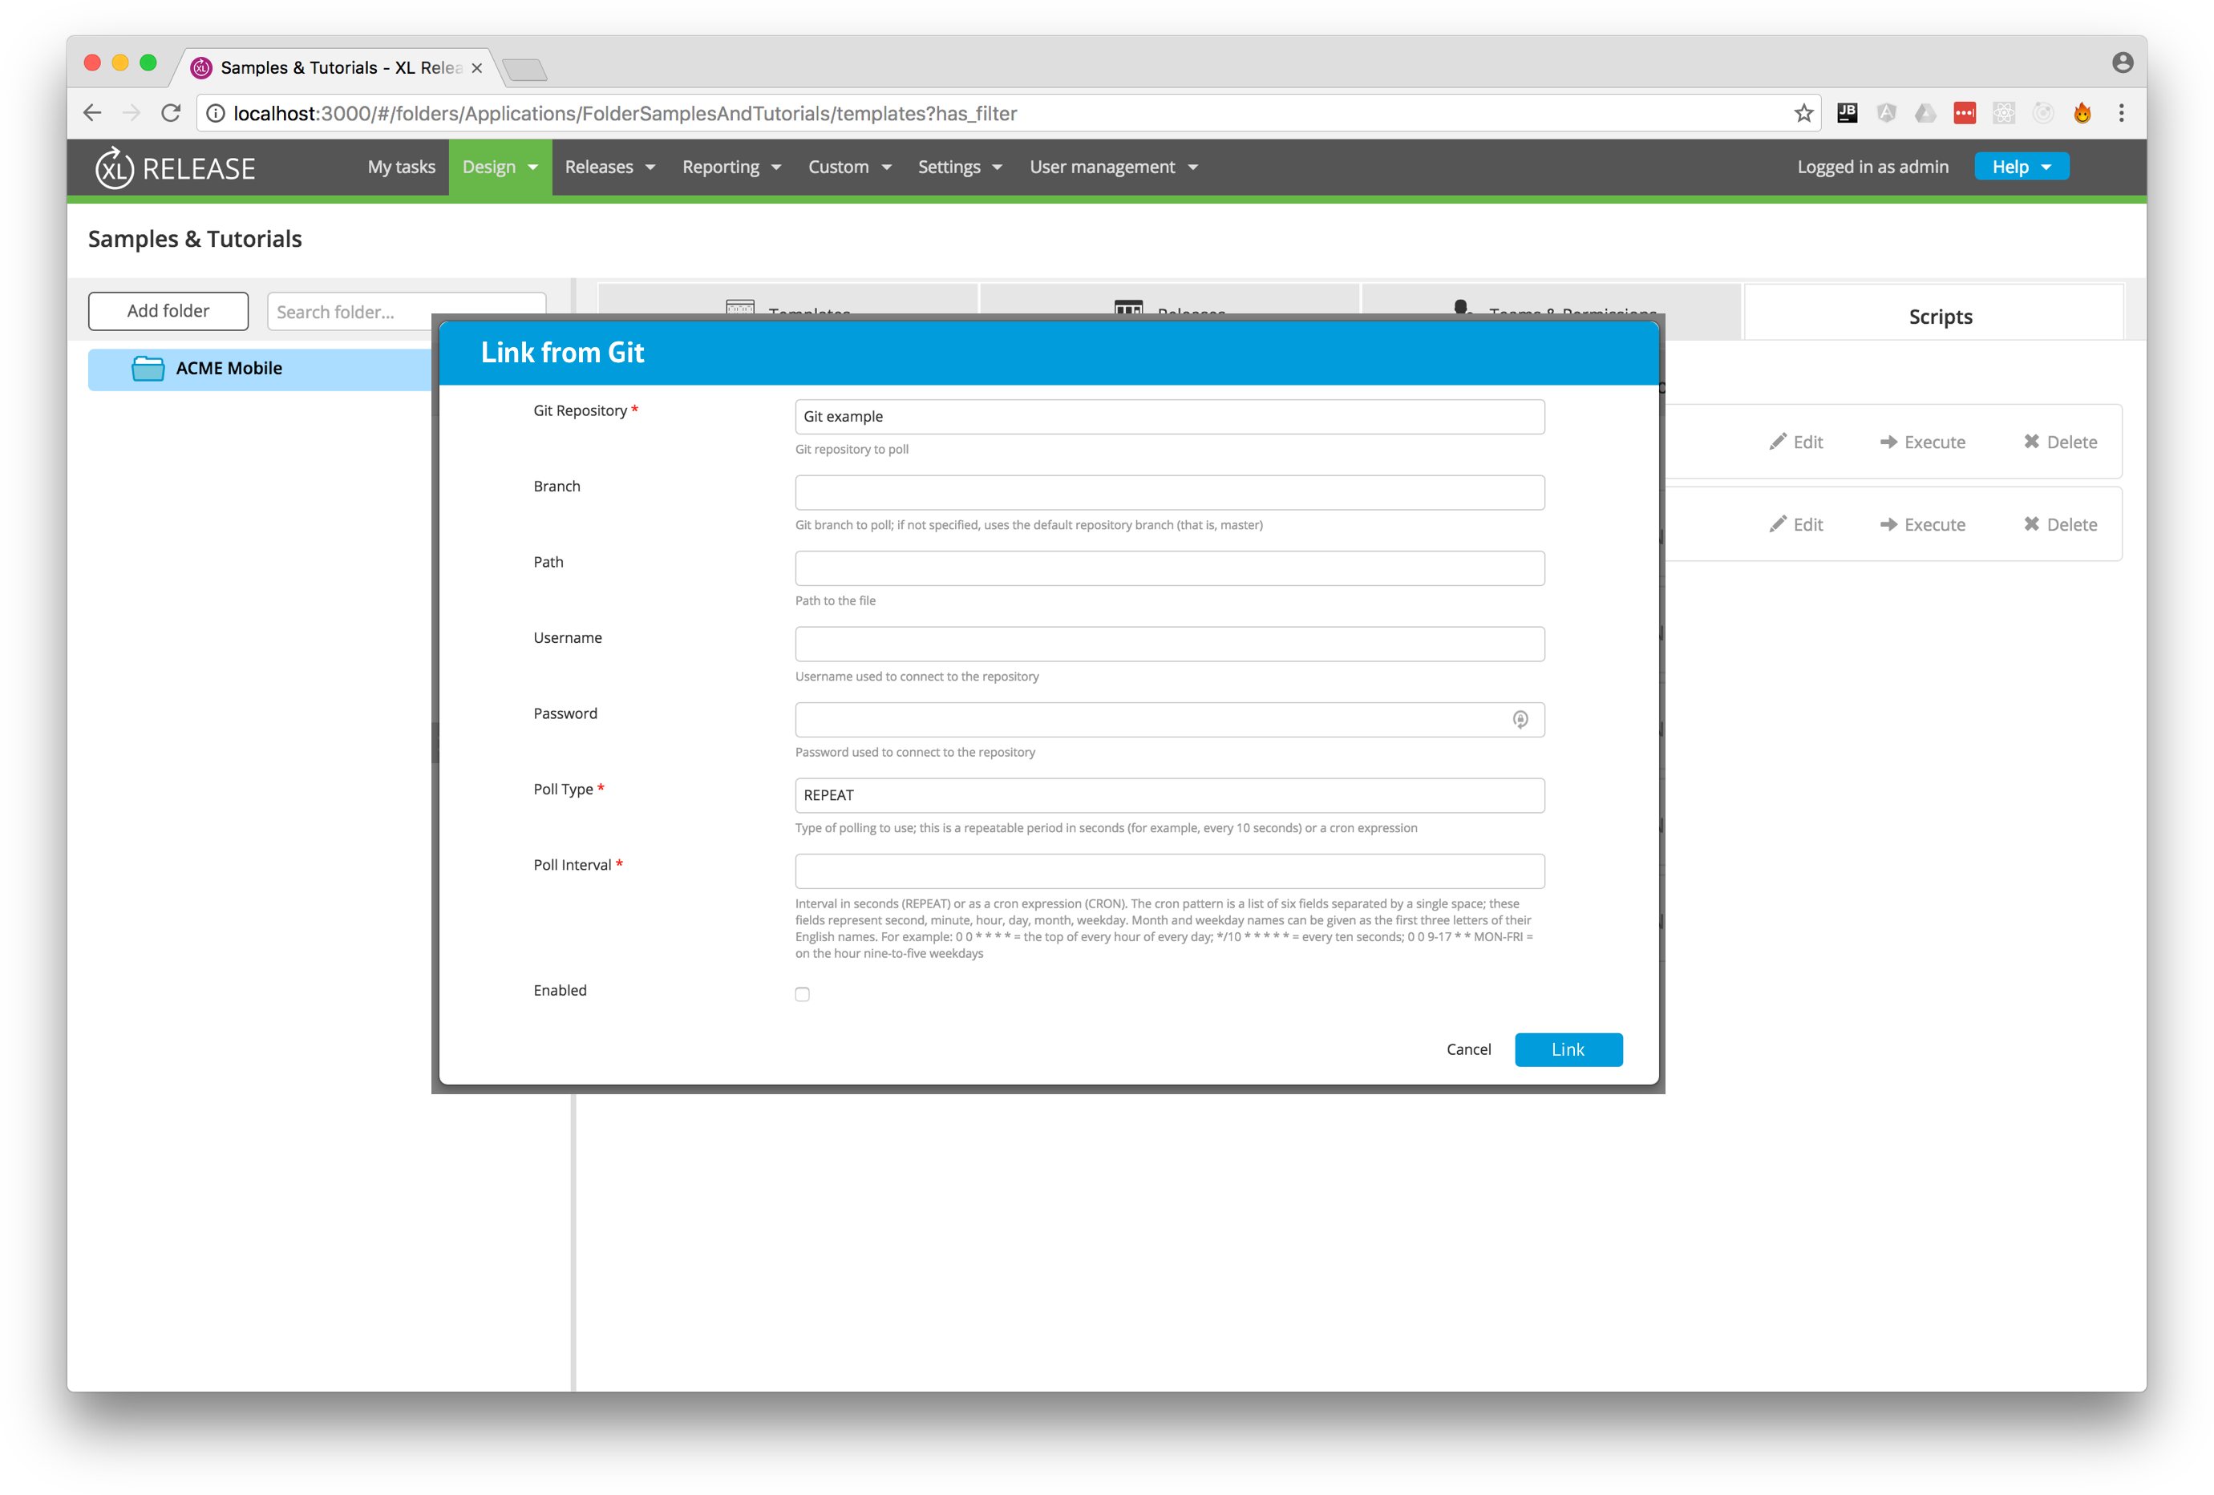
Link to SCM

Slide 25
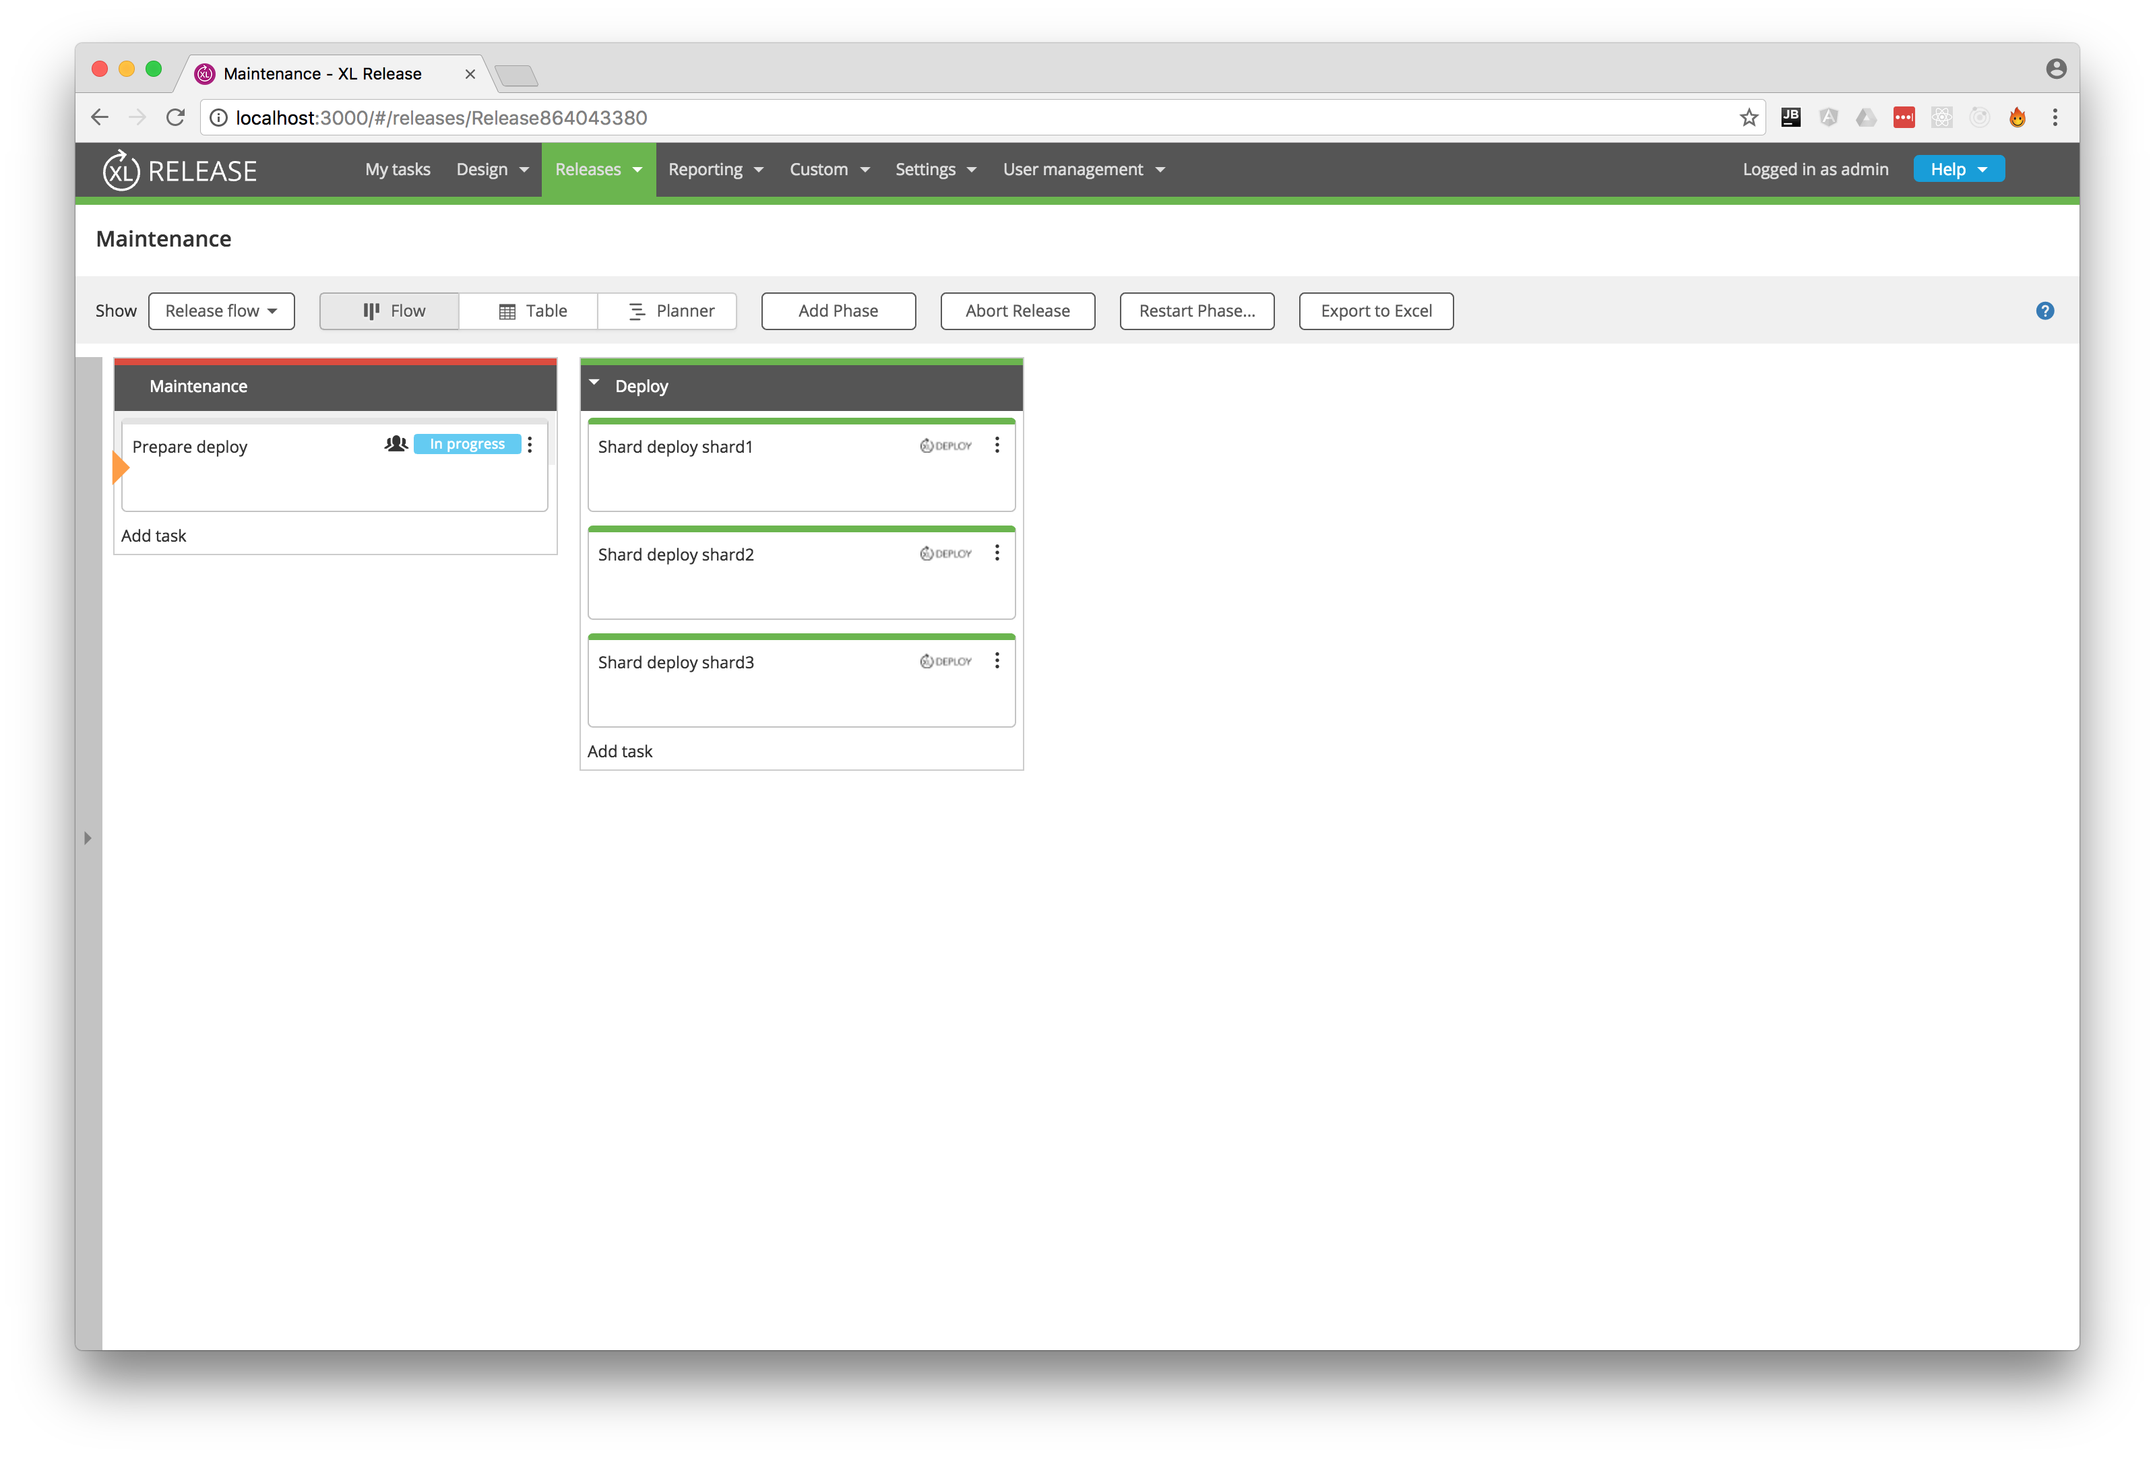
Results of DSL Execution

Slide 26
So…
What was the feedback???

Slide 27
Feedback summary
Consensus is 'everything as code’; not only releases/templates, but also provisioning/configuration of the system.
Everybody prefers Groovy over Jython.
Jython is OK to work with but will be a harder sell.
Nobody is interested in a command line interface.
Not much enthuasiasm for scripts as first class citizens in the XL Release UI / API.

Slide 28
Milestone 1 goals
Create a Groovy DSL to define templates, releases, etc.
Extend the script task to support the Groovy DSL in addition to Jython.
Extend the script task so that it can retrieve its script from an external source (URL) in addition to supplying it inline.

Slide 29
Then…
We ask for more feedback.
But we have some other ideas already.

Slide 30
Further ideas
Expose the full API to the Groovy DSL, i.e. create a Groovy API.
Extend custom script tasks to support Groovy.
Extend export hooks to support Groovy.
Extend triggers so that they can directly execute a script.

